Slide 1
Distance Velocity & Acceleration
Shock and Vibration

Slide 2
Definitions and Units
Displacement: Distance in specified direction (m)
Velocity: Rate of change of displacement with time. (ms⁻¹)
Acceleration: Rate of change of velocity with time. (ms⁻²)

Slide 3
Example
A body is at rest. It accelerates at 2ms-2 for 10 seconds. It then comes to rest in1 second.
Draw the acceleration – time graph
Draw the velocity - time graph
Draw the distance time graph

Slide 4
Acceleration - Time Graph

Slide 5
Velocity - Time Graph

Slide 6
Displacement – Time Graph

Slide 7
Acceleration Velocity Displacement
Slope of Graph is rate of change
The rate of change of displacement is velocity
The rate of change of velocity is acceleration.
Differentiation

Slide 8
Acceleration Velocity and displacement
Area under the graph is the total change
Area under Acceleration time graph is change in velocity
Area under velocity time graph is displacement
Integration

Slide 9
Equations of motion
v²= u² + 2as
v = u + at
s = ut + ½ at²
s: Displacement, u: Initial velocity,
v: Final velocity, a: acceleration, t: time

Slide 10
Example
A pack drops from 3m and hits the ground.
How long will it take to hit the ground?
What velocity will it be travelling at impact?
Acceleration due to gravity is 10 ms-2

Slide 11
Time

Slide 12
Velocity

Slide 13
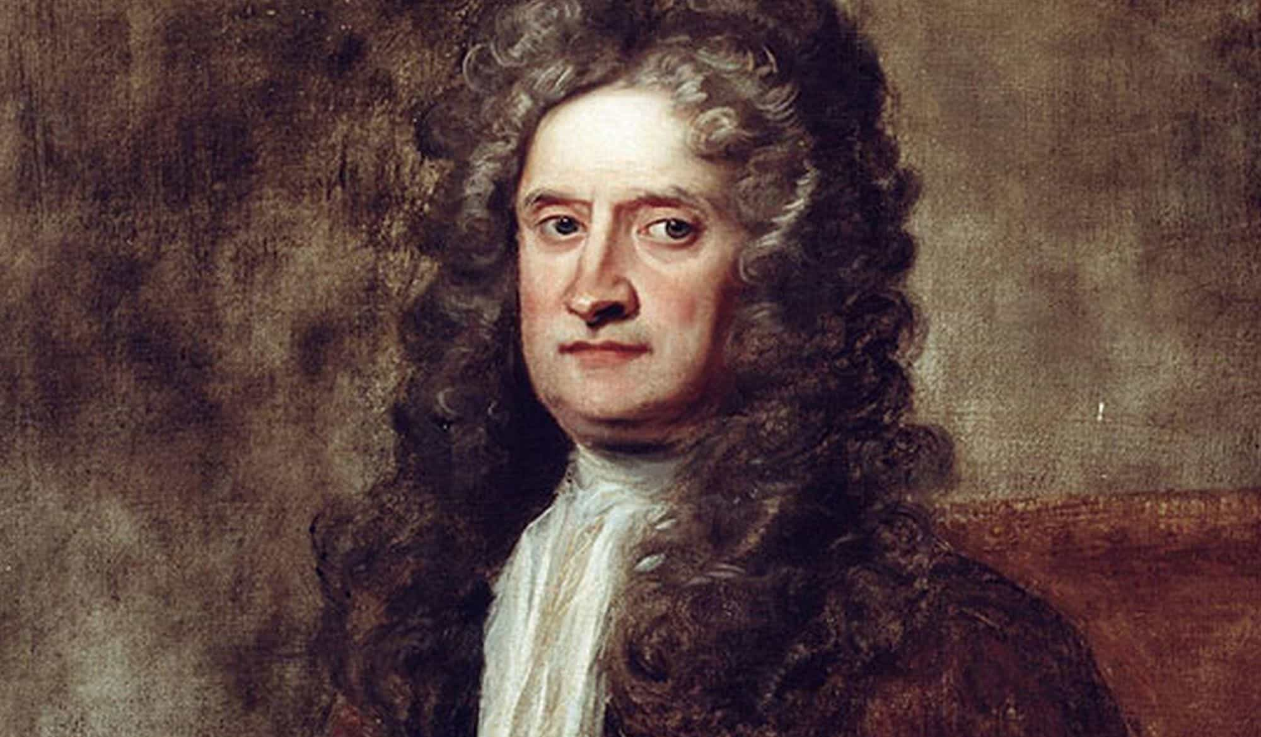
Physicist
Master of the mint
Alchemist
Mathematician
Theologian
Astronomer
Knight Templar

Slide 14
Newton’s laws of motion
Body stays at rest or moves with constant velocity unless acted upon by a force
Acceleration is related to mass and force applied (F = ma)
Every actions there is an equal and opposite reaction

Slide 15
Complete the table
Drop Height m | Impact velocity | Fall time
0.5
1
1.5
2
2.5

